Slide 1


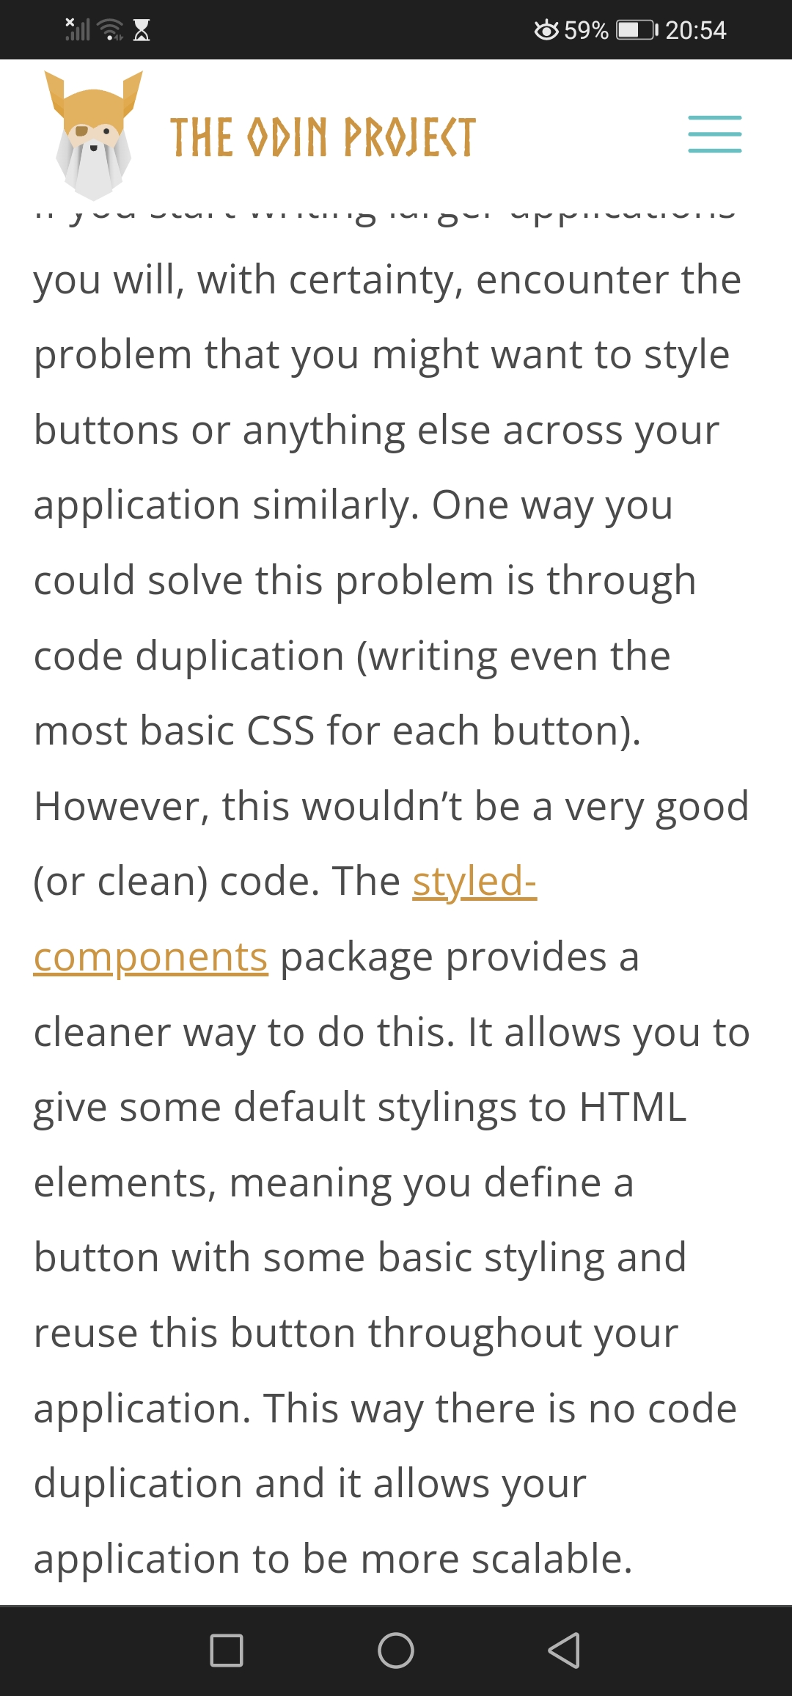
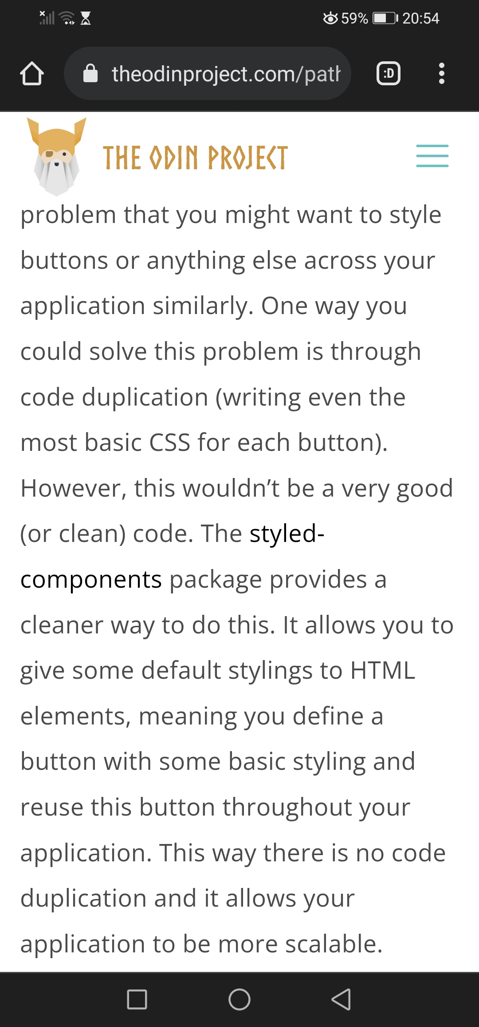
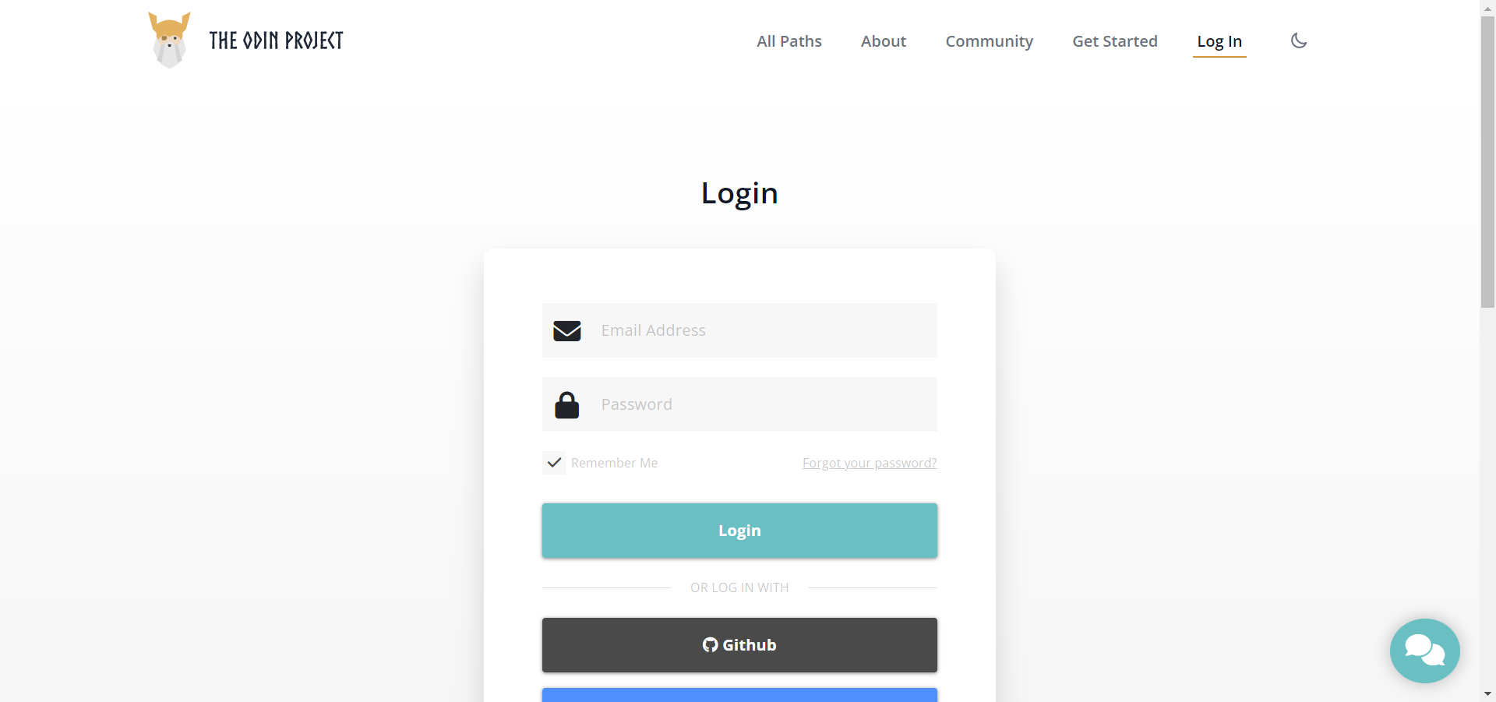
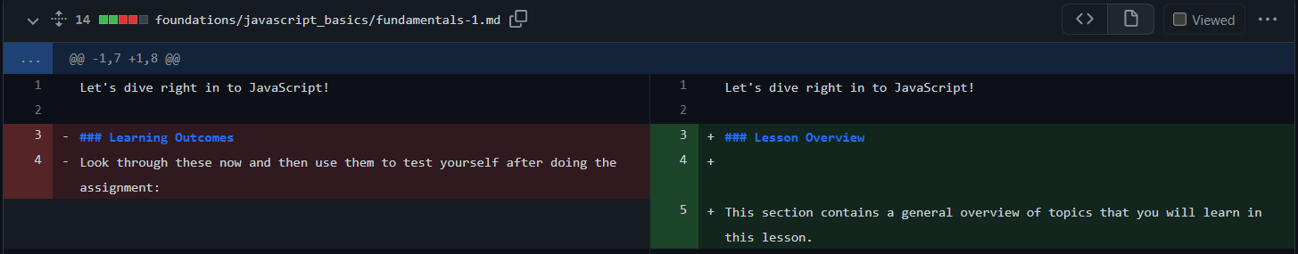
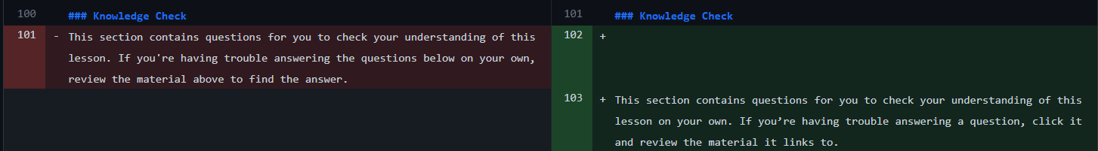
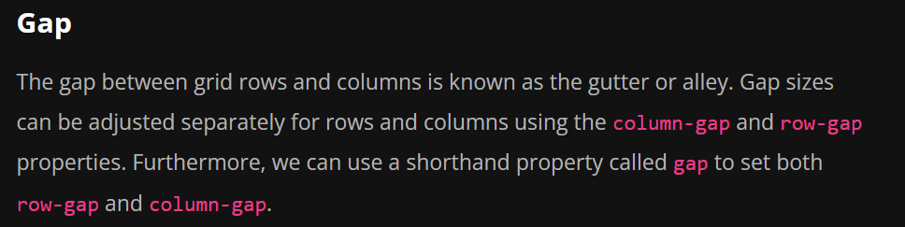
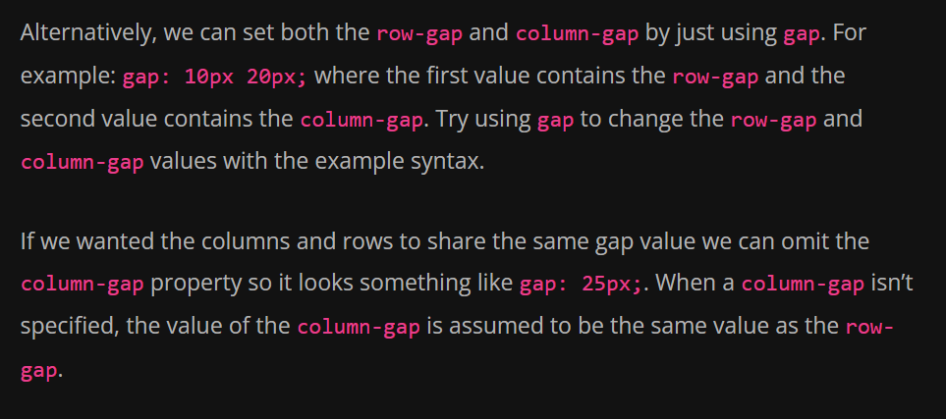

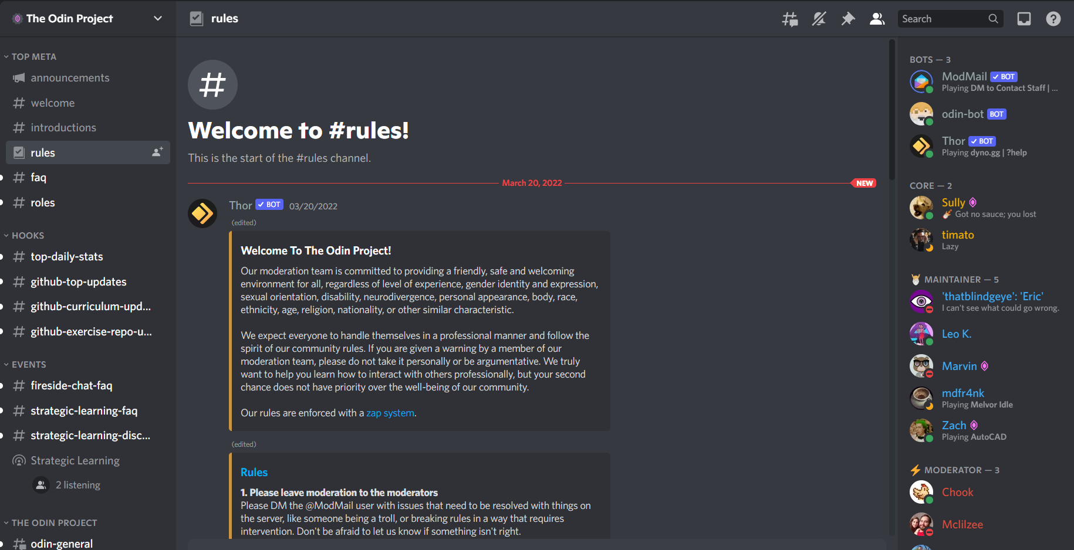
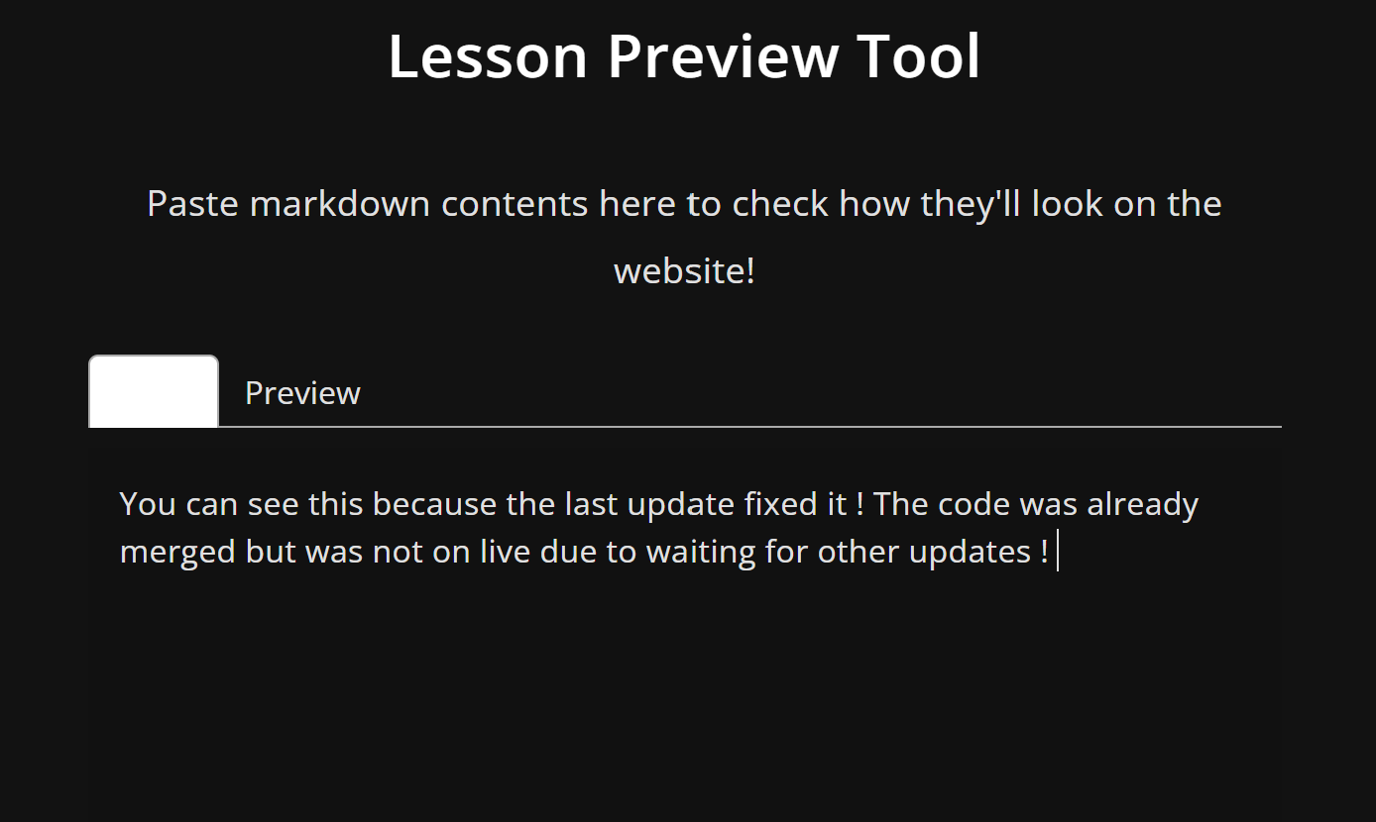
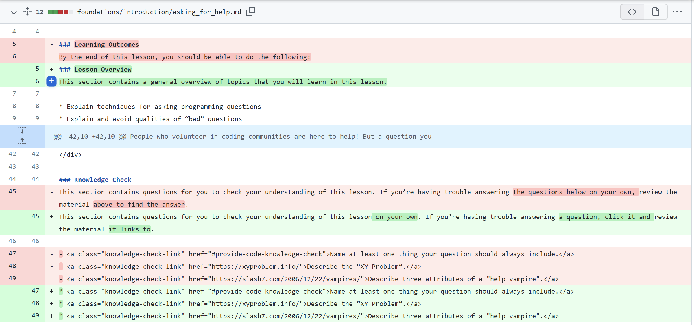
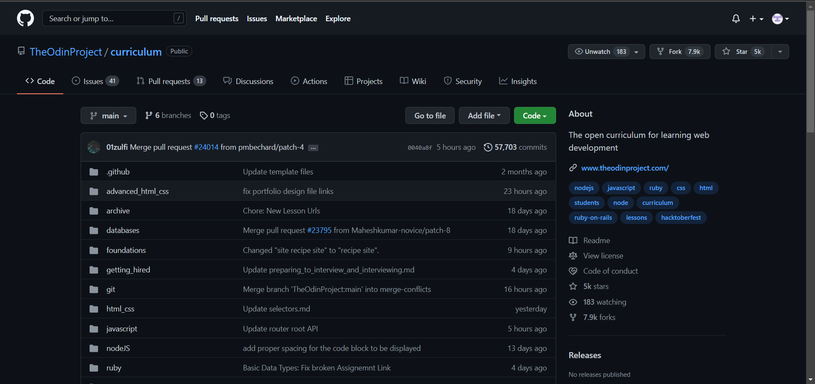
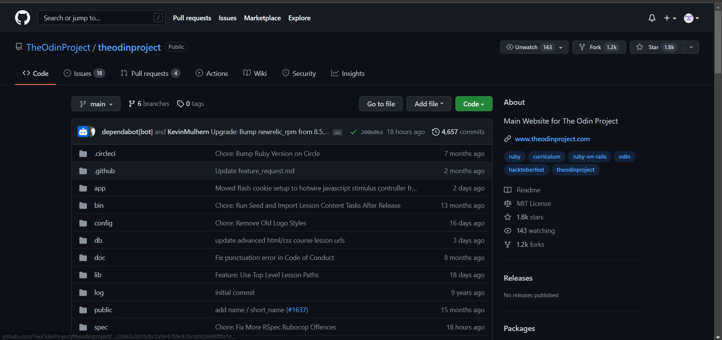
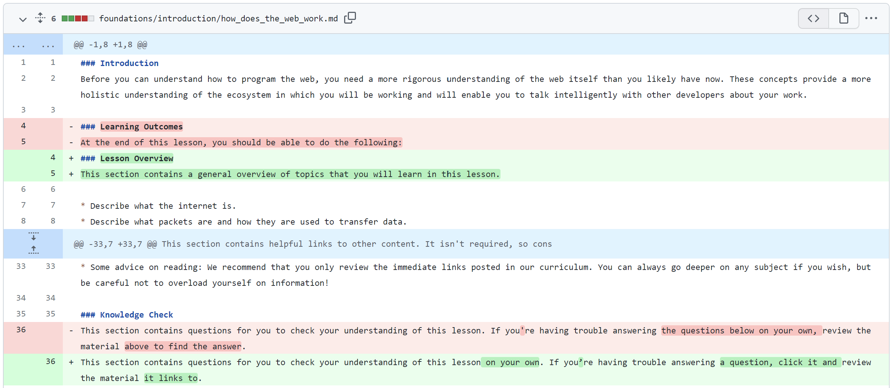
The Odin Project
Team Odin: Ian Wong, William Winn, Son Nguyen, Hoa Dao
Professor Grant Braught, Dickinson College, COMP491/492, Spring 2022
Introduction
Bug Gardening
Bug Fix
Contributions
What is The Odin Project?
The Odin Project (TOP) is a website used to teach people web programming for free. This includes HTML, CSS, JavaScript and Ruby. Anyone can create an account and start learning at their own pace. TOP offers a detailed yet dynamic curriculum on a wide variety of languages that is updated on a daily basis.
Issue #2532: Links blend in with text when focused
Description: A link is focused when you click it with your mouse or, if you're on mobile, when you tap on it. When the link is focused, it's indistinguishable from regular text.
Issue #23784: Creating a Grid Lesson: update Gap section
Description: The old lesson alludes that gap can only be used to set the column-gap and row-gap to the same value, but it is also able to set column-gap and row-gap to different values.
Solution: We added a paragraph to explain how gap can be used to set two distinct values for column-gap and row-gap and encouraged the student to test it out.
Upon further review, the reviewers determined that adding more information to explain the usage of gap was intentionally left out to avoid confusing beginners.
We replaced the initial changes with just a sentence implying gap has more usages and to encourage the student to try using it.
Issue #23934: Style Guide – Foundations/JavaScript Basics 1: Learning Outcomes and Knowledge Checks
Description: To make lessons consistent, the goals of a lesson and knowledge check sections of each lesson need to be changed.
Solution:
Learning Outcome is renamed to Lesson Overview and the text under the Lesson Overview and Knowledge Check sections are changed. All Knowledge Check links should follow the stated format in the issue.
Investigation:
We confirmed that this was a real bug by testing on PC and on mobile and suggested to change the specific link text to yellow, such that if one were to click a link, the text would stay yellow. A reviewer said our solution would work, but they have been planning to do a major CSS rewrite.
TOP also has a strong community based in their Discord server (linked below). Discord is an online platform for users to chat through text chat, voice call, or video call and users can join communities or "servers" like TOP's Discord Server to get and receive help from others. There are many sub-channels within the main channel that offers help on curriculum materials, general knowledge, GitHub issue tracker bot, and so much more. The community is also very active and maintained by helpful and friendly moderators.
Before:
Initial Changes:
Challenges
Final Changes:
Most of us were familiar with HTML and CSS, but are not well versed in JavaScript, so we spent some time going through TOP's foundation course to educate ourselves in HTML, CSS, and JavaScript.
During the developer install, we could not pass all tests for a while and spent a lot of time trying to fix errors Ruby errors
Additionally, none of us had any previous experience with Ruby
During the beginning of our Bug Fix activity, we had a hard time looking for issues to fix. This is due to the small number of issues in both the curriculum repository and theodinproject repository.
During the contribution phase we made some mistakes by accidentally deleting our workflow on GitHub. Had to remake new PRs to fix the issue.
Issue #2540: Font gets dimmer (so dark its almost unreadable) as users type into the Lesson Preview Tool in Dark Mode.
Description: The font appears to be dimmed and unreadable when users type into the preview tool text box when Dark Mode is turned on. We tried to reproduce it and it appeared differently on different display panels (easy to read for Mac but very dim on Windows machines).
Issue #23928: Style Guide – Foundations/Introductions: Learning Outcomes and Knowledge Checks
Description: To make lessons consistent with the new guidelines on verbiage and format, some headings and description texts needs to be updated.
Solution: Learning Outcome is renamed to Lesson Overview and the text under the Lesson Overview and Knowledge Check sections are changed. All Knowledge Check links should follow the stated format in the issue.
Developers
Since TOP is open source, developers can contribute to TOP on their GitHub, either by improving lesson content in the curriculum repository or fixing bugs and adding features to the main webpage in theodinproject repository.
What have we learned?
We have gotten more comfortable with making changes to files and pushing those changes online
Improved our fundamental understanding of Git
How rspec works to test Ruby based applicaitions
Gained experience using Linux's command line interface to help navigate a code repository
Investigation:
We confirmed that the bug existed before and depending on display panels it would show up differently. The issue is now closed as a major CSS rewrite has fixed it.
TOP main page: www.theodinproject.com
TOP GitHub: github.com/TheOdinProject
TOP Discord: https://discord.com/invite/fbFCkYabZB
www.dickinson.edu

